Slide 1
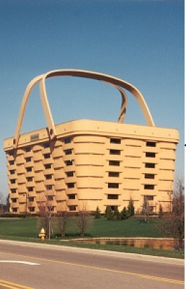
NVK GROUP & SONS
LOCATION
BH-1,Deoghat , Jhalwa
Allahabad
211012

Slide 2
Task #1 - Conduct Initial Market Research

Slide 3
These sectors include:
• Transport Sector, which deals with transporting tourists (both domestic
and international) in and around South Africa, e.g. airlines, shuttles,
trains, buses, ships, taxis, etc.
• Travel Agents, whose main function is to sell the temporary use of
transport (air, rail, road and water), accommodation, tours and other
associated services
• Tour Operator, who is a person that owns a business which transports
paying tourists on scheduled itineraries and makes arrangements for their
clients in terms of accommodation, transport and excursions
• Tour Guide, which is any qualified person who, for monetary or other
reward, accompanies people who are travelling through or visiting any
place within the country and furnishes those people with information or
comments regarding the places or objects visited

Slide 4
Marketing your Tourism Business
Once you have your tourism business up and running you will need to
attract customers and keep them. All tourism companies – from small
guesthouses to large hotel groups with their own marketing departments –
market themselves in one way or another.

Slide 5
creating something which potential customers want
• offering your product in a place which is convenient and attractive to
customers
• offering your product at a price which is reasonable and fair
• letting potential customers know about your product through the many
forms of communication
• attending local and international exhibitions

Slide 6
The marketing mix looks at the four main factors that need to be
considered to make your business successful:
1 Product
The first factor we call product. For example this may be a room at your
guesthouse, a tour, or a restaurant meal. It is what people want to buy, that
meets their specific needs.
2 Price
The next one we call price which is one that people are prepared to pay for
your product. Getting the right price is crucial. A reasonable price is one in
which offers the customer value for money (VFM).
3 Place
The third factor is place which means that the product has to be accessible
and available to customers so that they can actually buy it.
4 Promotion
The fourth ‘P’ of your marketing mix is promotion. Once you have the right
product, at the right price and in the right place, you need to promote it.
You must let your customers know that you have a product ready to be
purchased.

Slide 7
One of the most common
methods used to make sure that your promotion is effective is a formula
known as AIDA. This stands for:
- Attention – getting the attention of a potential consumer – the use of
colours, humour, photographs and so on.
- Interest – the content of the advertisement must keep the
customer’s interest.
- Desire – the advertisement should create desire in customers to buy
your products.
- Action – the last stage of AIDA is to show your customers how they
can actually go about buying your product – in other words, action.

